Slide 1
BASE FUNCTIONALITY
Admin levels
  Super User/Admin hos Integ
  Super User/Admin hos kund
  Team Leader Invites Team Member through e-mail
  Team Members can:
    Read and navigate whole Toolkit
    Change text in Action Plan (only own action steps)
    Add new actions steps for themselves
    Add new data to team metrics
    Add Teamdocuments
User Interface
  Visually attractive – fun to work in
  Easy and intuitive navigation
  Should feel like our own toolbox – not a control instrument
Robust and low cost to run, support sustain and maintain
  Easy to install in customer digital environment
  Adjustable to different customer needs

Slide 2
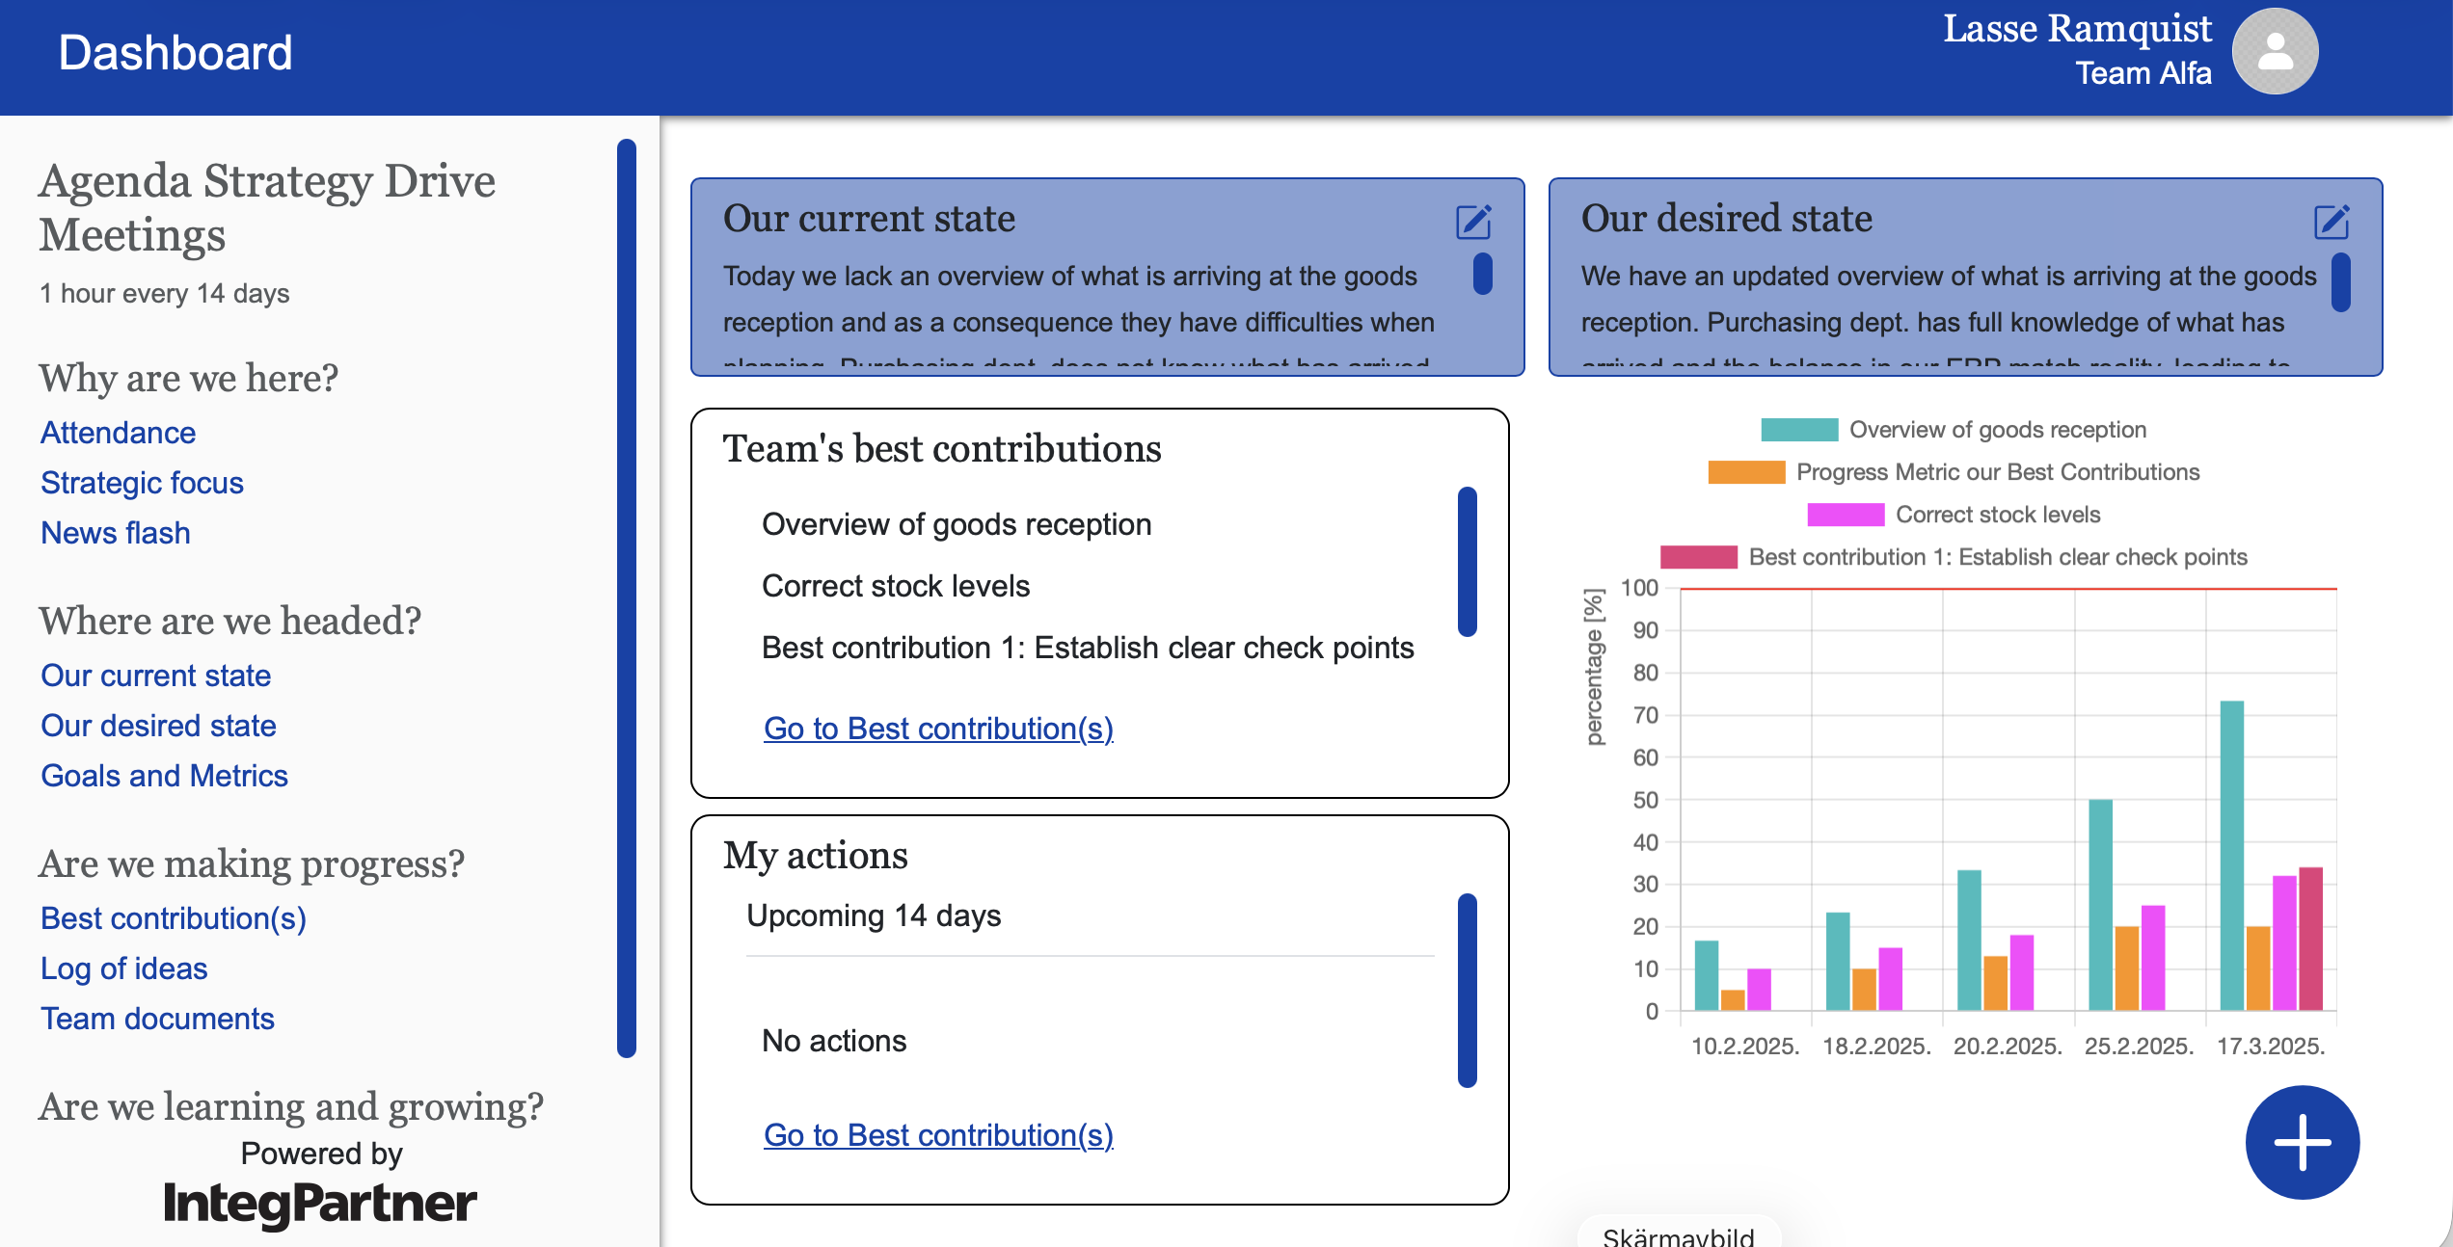
Dashboard (for individual User)
Change to text + link:
Strategic Focus & Progress
Tool to design metrics
Links to existing KPI

Slide 3
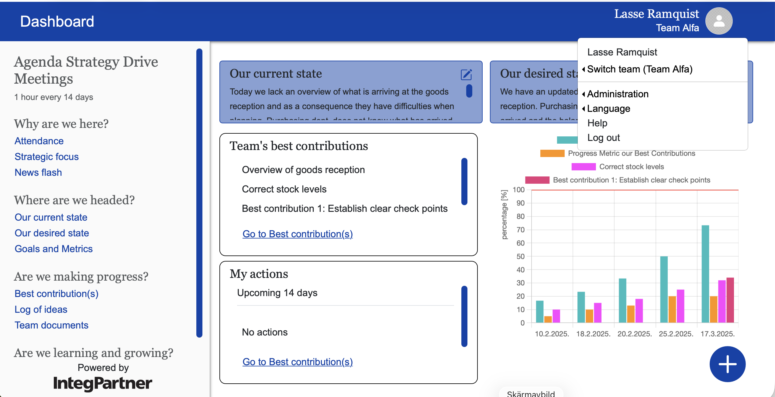
Admin functions

Slide 4
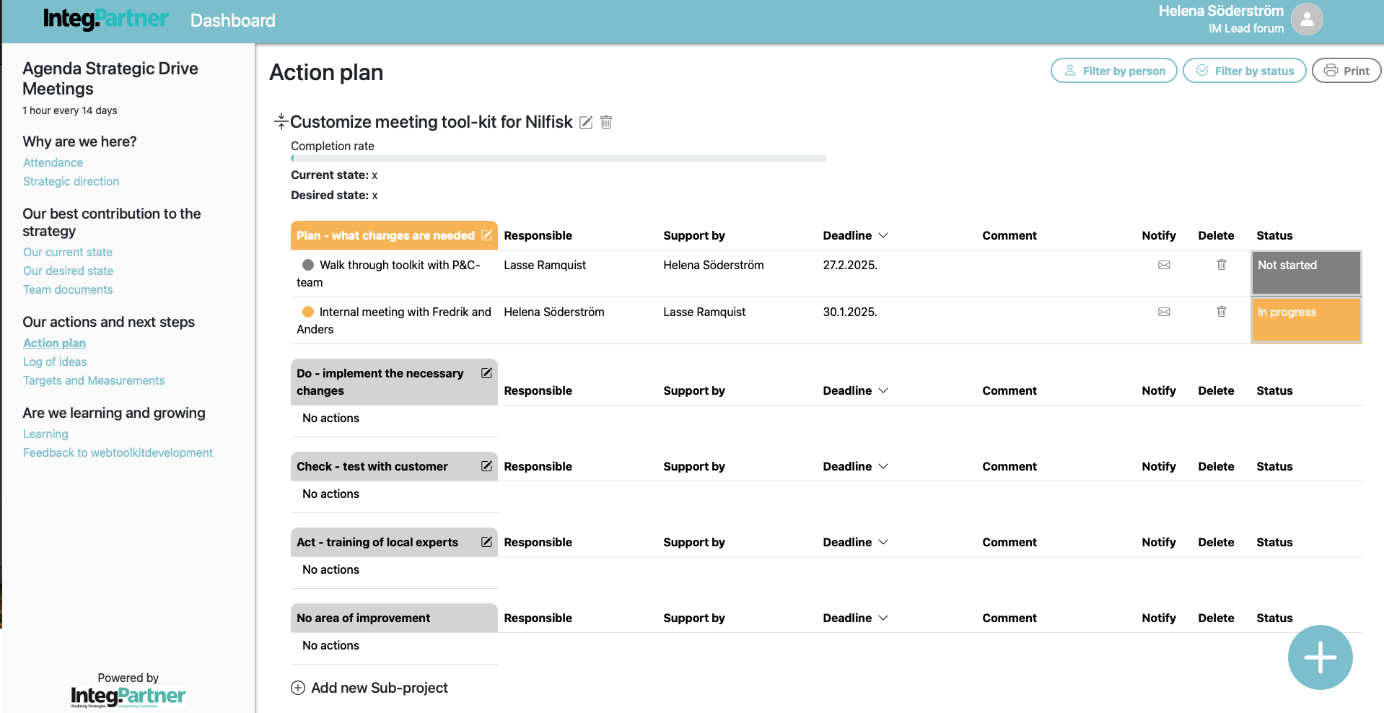
Change to:
"Teamwork Agenda"
Change to: "Where are we headed and why?"
Strategic Focus
How are we doing?
Change to:
"What are we aiming for?"
Change to:
Our Desired state
Our Goals and Metrics
Change to:
Team Documents
Change to:
Our Learnings
Our Teamwork Rules

Slide 5
Action plan
Actionplan är kopplad till:
Best Contribution/Assignment:
Desired State & Completion Rate %:
Metric and Goal:
What is needed and why?
Actions? Next steps?
Status
Notify
Archive
Delete
Responsible? Support from?
To be done by?
Comments
Main problem or improvement area
Action step #1
For action step #1
Action step #2
For action step #2
Action step #3
Action step #4
Until complete...

Slide 6
Tracking toolkit #1
Share, of worked hours, spent with a customer
Measurement
(What shall we
measure?)
100%
Team focus :
Target level
To become more customer focused
90%
80%
Desired State
70%
Our sales people are spending more time at the customer
Actual value
60%
Critical line
Planned development
(Updated every week or biweekly)
50%
(Linear or Variable)
40%
Actual Value
How are we doing really?
30%
Starting point
(Estimated or real
starting point)
Critical Line
What do we want our development to look like?
20%
10%
End Target level
How good do we want to be
when we are done?
0%
Time/date/week
240
242
244
246
248
250
252
302
304
306
308
310
312

Slide 7
Progress Measure (PDCA)
Tracking toolkit #0
Your Best Contributions | PLAN: Analyze what is needed |  | DO: Implement - take action |  | CHECK: Does it work? |  | ACT: Evaluate, and improve |  | PROGRESS: Degree of completion
Xxxxxxxxxxxx | 25 | 20 | 50 | 30 | 10 | 5 | 15 | 0 | 100 | 55
Yyyyyyyyyyyy |  |  |  |  |  |  |  |  | 100 | 35
Zzzzzzzzzzzz |  |  |  |  |  |  |  |  | 100 | 75
When all of it is complete = 100% |  |  |  |  |  |  |  |  | 100 | 55

Slide 8
Tracking toolkit #3
Any relevant existing KPI that will provide lagging confirmation that Best Contribution work has been effective and you can see a breakthrough in a lagging KPI.
In the toolkit this will simple be viewed through a link/address to the correct internal KPI-library.

Slide 9
ÖNSKAD ADDERAD FUNKTIONALITET i PRIO ORDNING
Knapp som väcker IntegChatte
  Då matas Integ i RunTime med alla Teamets data från Toolkit (Integ har access till kontext)
  Integ ska kunna lyssna på allt som sägs (typ Co-pilot)
  Formuleringsstöd på begäran (Främst Action Plan + Desired State)
  Möjlighet att skriva in förslaget direkt i Toolkit (Måste dock justeras/godkännas av ansvarig)
På fråga från teamet/enskilda Users ska IntegChatte kunna:
  Summera dagens möte samt lyfta fram och erkänna framsteg
  Summera vilka framsteg "företaget" gör kopplat till strategiska fokuseringar
  Ge teamet en eller två reflektionsfrågor inför punkten "Learnings" på agendan
  Kunna hänvisa/tipsa om andra team som jobbar med snarlika frågor
Integ behöver "run time fönstret" ha access till:
  Kontentan av Strategiskt Resonemang
  Uppdaterat Stragiskt Fokuserat Lokomotivmål
Löpande datainsamling under mötet som stöd till vitalitet och framdrift (Ej prio nu, men låt oss ta höjd för dessa redan nu)
  Antal deltagare (%) som ger egna muntliga bidrag under mötet = indikator #1
  Antal tillfällen då en deltagare bygger vidare på en kollegas inspel = indikator #2
  Antal perspektivkrockar som landar i samsyn= indikator #3
  Antal "action steps" som bockas av + adderas = indikator #4
  Bekräftad samsyn om Bästa Bidrag, Mål och Desired State #5
  Antal kollegiala erkännanden = indikator #6
  Hög närvarao = indikator #7
  ....
  Antal "action steps" som glider bortom ursprunglig färdigtid = vitalitetssänke #1
  Antal perspektivkrockar som lämnar känslor av frustration och friktion = vitalitetssänke #2
  Antal signaler som indikerar att mötet/frågorna som diskuteras inte känns vikiga/angelägna = vitalitetssänke #3
  Hög frånvaro (%) = vitalitetssänke #4
  ....

Slide 10
Two ways of measure that complement each other
Performance INDICATORS
MeasurE Completion Rate (PDCA)
Strenghts
  Can measure ”cause” & ”effect”
  Helps us mobilize our forces in day-to-day work, as well as in our improvement activities
  Provides proof of a new level of performance
  Mirrors how close we are to our desired state
  Major incomplete cycles stay top of mind!
Drawbacks:
  Can sometimes be quite slow in telling us if we are on the right track or not
  Can take a long time before you see any major improvement in performance
Strenghts
  Measures progress with eliminating "root causes”
  We get a narrower and sharper focus in our gap closing/best contribution work.
  It constantly generates new and relevant action steps
  Shows our tempo, if we have the pace we need
  It constantly produce new complete cycles!
Drawbacks:
  Without a Performance Indicator you will not know if you are working on the right things
  It provides no direction or focus to guide your day-to-day work

